Slide 1
Module 2: Basic technical for digital forensics

Slide 2
Topics
Basic Computer Operation
Bits & Bytes
File Extensions & File Signatures
How Computers Store Data
RAM: Random Access Memory
Volatility of Data

Slide 3
Topics
The Difference Between Computer Environments
Active, Latent, and Archival Data
Allocated and Unallocated Space
Computer File Systems

Slide 4
Bits & Bytes

Slide 5
Bits & Bytes
A Bit is 0 or 1
8 bits is a byte
  00000000 to 11111111
  256 possible bytes
  Can be written as a number 0 to 255
  In Hexadecimal, 00 to FF

Slide 6
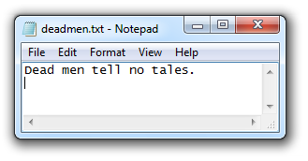
ASCII Text
One byte per character
7 bits encode character, one parity bit
94 printable characters
Originally used for English
Adapted to other languages

Slide 7
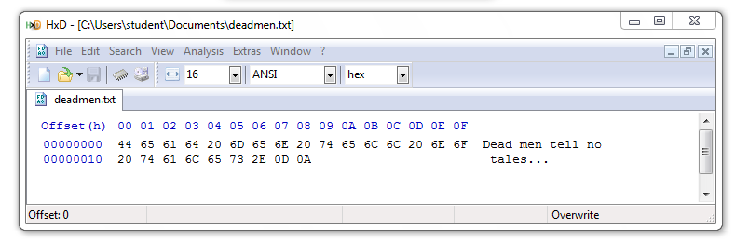
ASCII file in Hexadecimal
20 hex = 32 decimal = SPACE
0D 0A = 13 10 = CR LF

Slide 8
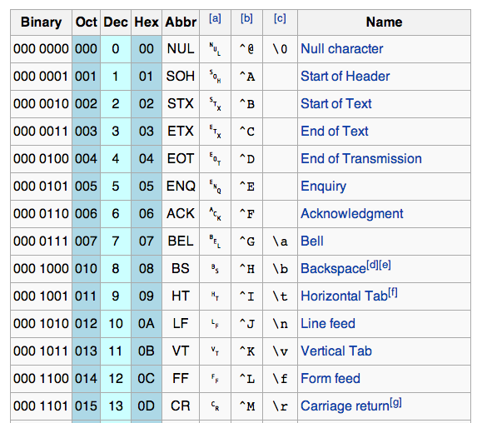
ASCII

Slide 9
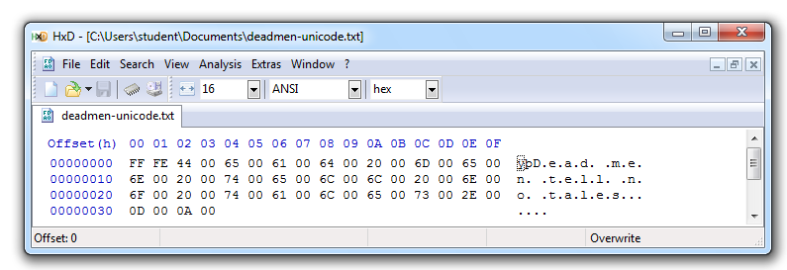
Unicode
Encodes all "commercially significant" languages
Two bytes per character
FF FE at the start is a Byte Order Mark

Slide 10
File Headers & File Carving

Slide 11
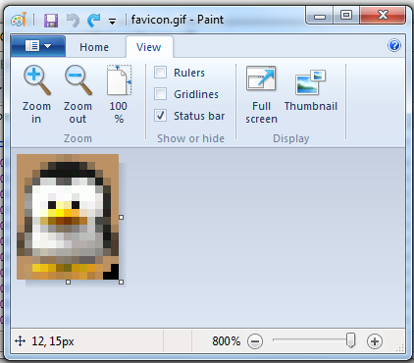
GIF Image (13x16 pixels)

Slide 12
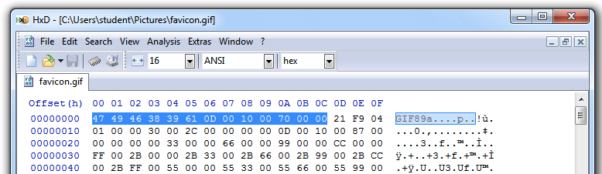
GIF File Header
GIF89a – Version of GIF
0D 00 0A 00 – 13 pixels x 16 pixels

Slide 13
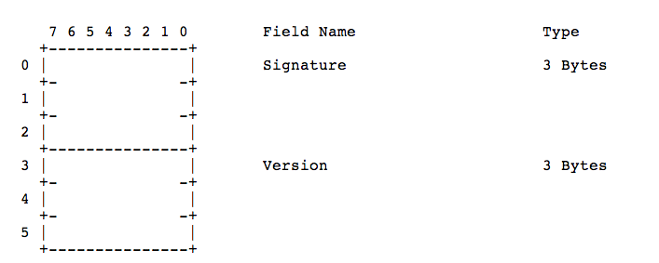
GIF Specification

Slide 14
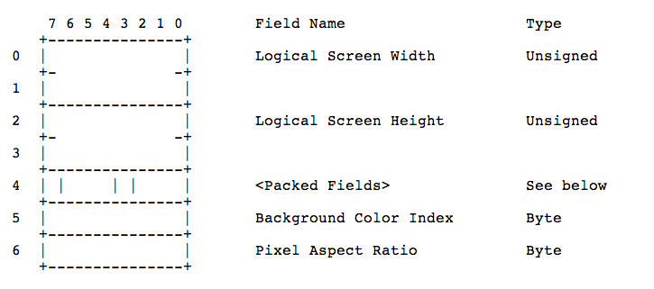
GIF Specification

Slide 15
File Carving
Rebuilding files by assembling blobs of data found on a disk
Relies on file headers and footers
Done automatically by all-purpose forensic suites like FTK and EnCase
Many other tools exist to carve files

Slide 16
File Extensions & File Signatures

Slide 17
File Extensions
Usually three letters long
Appear at the end of a file name, after a dot
Hidden in Windows by default
Used to specify the file type, icon, and default application

Slide 18
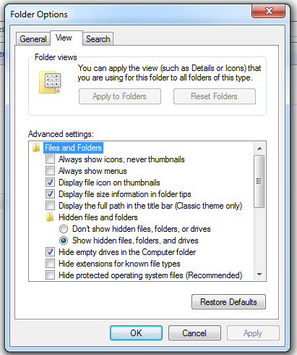
Hide File Extensions

Slide 19
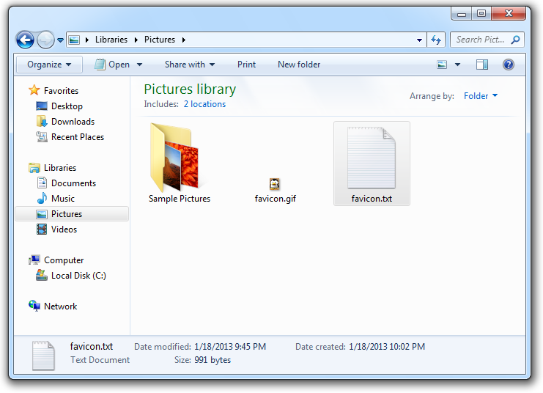
Incorrect File Extension

Slide 20
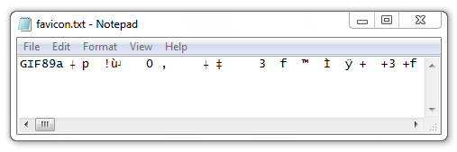
Wrong Default Application
Any stream of bytes can be interpreted as ASCII

Slide 21
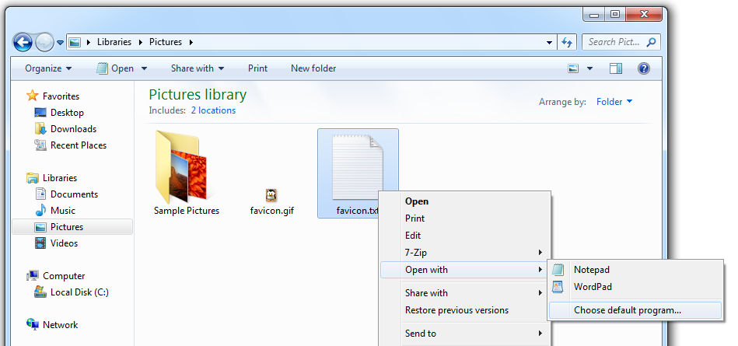
Open With…

Slide 22
How Computers Store Data

Slide 23
Storage Methods
Electromagnetism
  Hard disks and floppy disks
Microscopic Electrical Transistors
  SSDs, USB flash drives, SD cards, etc.
Reflecting Light
  CDs, DVDs, Blu-ray
They are all nonvolatile – they retain data without power

Slide 24
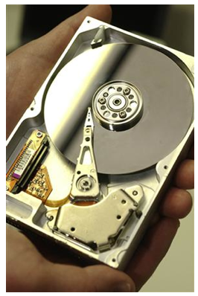
Magnetic Disks
Platter spins at 7,000 rpm to 15,000 rpm
Spindle is the axis
Read/write head is an electromagnet mounted to an actuator arm
  Image from textbook

Slide 25
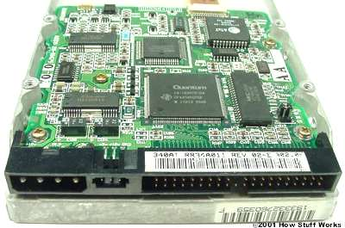
Disk Controller Card
Stores and retrieves data from the platters
Controlled by firmware stored in the Host Protected Area
  Image from http://static.ddmcdn.com/gif/ide-controller2.jpg

Slide 26
Flash Memory
Made of transistors
Solid State Devices (SSDs)
  Faster than hard disks
  Use less power
  More expensive

Slide 27
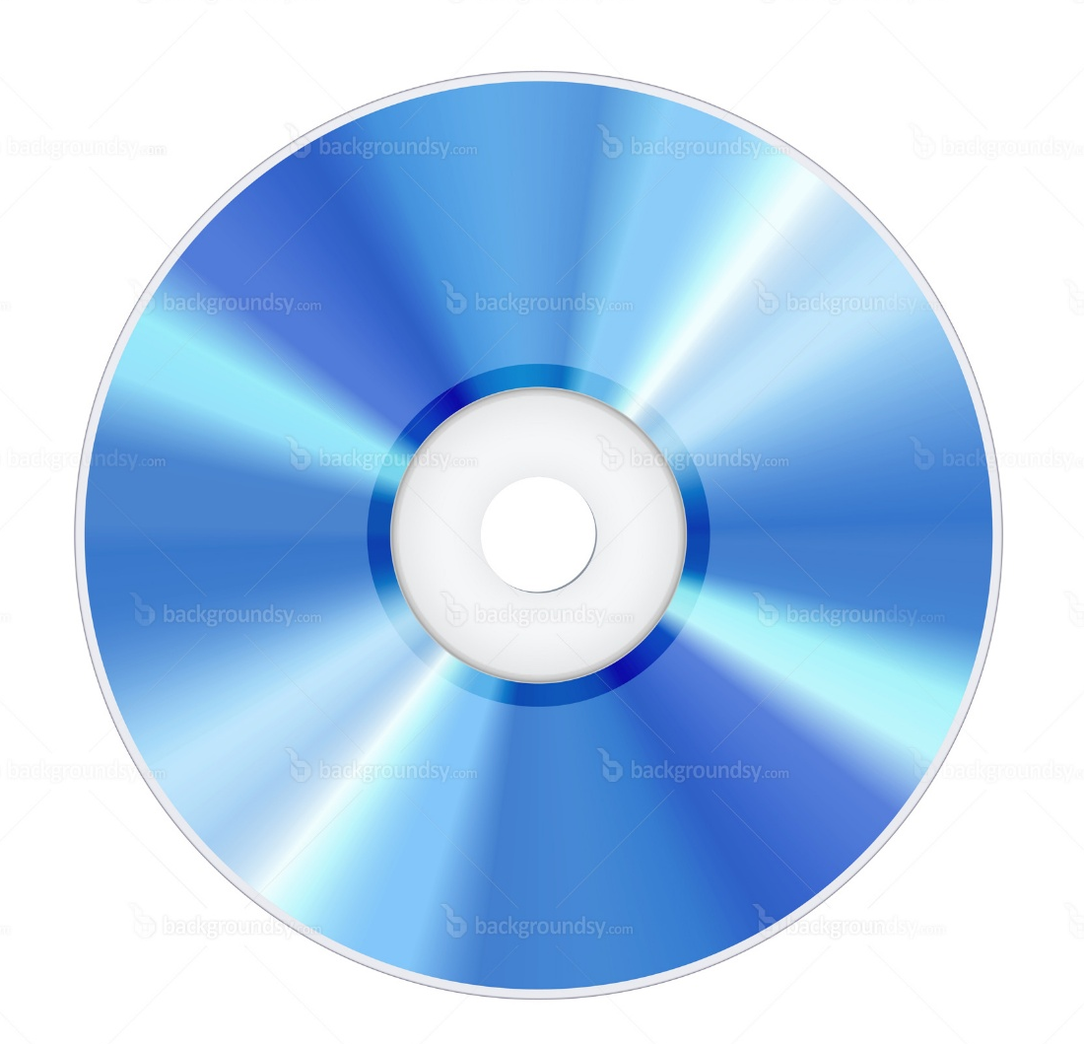
Optical Storage
Microscopic pits encode bits
Area between pits are called lands
There is one long spiral track for the whole disk
Data is read with laser light
  Image from http://www.backgroundsy.com/file/large/blu-ray-disc-isolated.jpg

Slide 28
Volatile v. Nonvolatile Memory
Memory is short-term storage
Storage devices (hard disks, SSDs, and optical disks) are nonvolatile—data is retained without power
RAM is main system memory
  RAM is volatile—data is lost when power goes off

Slide 29
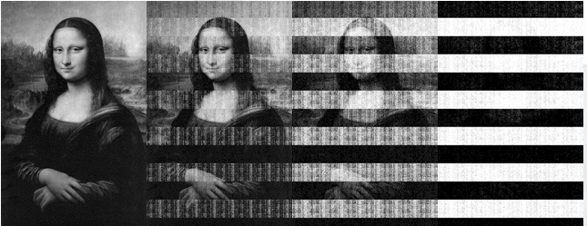
Volatility of RAM
5 sec
30 sec
60 sec
5 min

Slide 30
RAM Forensics
RAM contains important evidence that is not normally written to the hard disk
  Instant messages
  Network connections
  Running processes
BUT there are no time-stamps on RAM contents
  It can be misleading

Slide 31
Computing Environments

Slide 32
Four Categories
Stand-alone
Networked
Mainframe
Cloud

Slide 33
Stand-Alone
A computer not connected to any other computer
  Such as a laptop not connected to Wi-Fi or cellular data
  BUT networks are everywhere now, even in BART or on airplanes

Slide 34
Networked
A computer connected to at least one other computer
Evidence might be on servers and network devices as well as the local computer
Almost every computer is networked now

Slide 35
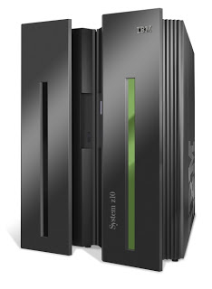
Mainframe
A powerful computer used at a business, or shared by many users
Located in a data center or colocation center
  Image from http://danialsharifudin.blogspot.com/2012/08/classification-of-computer.html

Slide 36
Cloud Computing

Slide 37
Examples of Cloud Computing
Gmail
Facebook
Twitter
Amazon Web Services
CloudFlare

Slide 38
Cloud Services
Infrastructure as a Service (IaaS)
Platform as a Service (PaaS)
Software as a Service (SaaS)

Slide 39
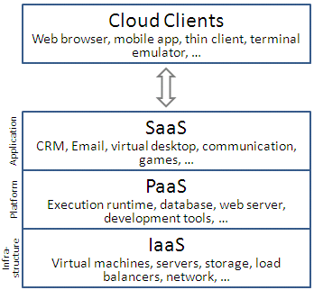

Slide 40
IaaS
The most basic cloud service
Outsources hardware needs
  Servers, storage, routers, switches…
Examples
  Amazon EC2
  Windows Azure Virtual Machines
  Google Compute Engine
  Rackspace Cloud

Slide 41
PaaS
Provides a computing platform
  OS, programming language execution, database, and Web server
Examples
  AWS Elastic Beanstalk
  Heroku
  Google App Engine
  Windows Azure Compute

Slide 42
SaaS
Providers install and operate application software in the cloud
Users access the software from cloud clients
Examples
  Google Apps
  Microsoft Office 365

Slide 43
IaaS
Outsource hardware needs
  Servers, storage, routers, switches…
Examples
  Amazon EC2
  Windows Azure
  Google Compute Engine

Slide 44
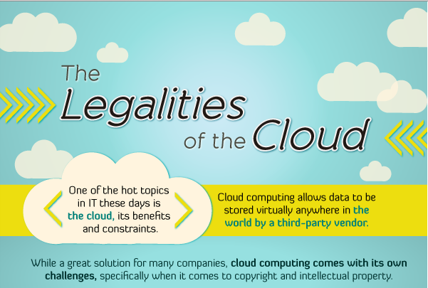

Slide 45
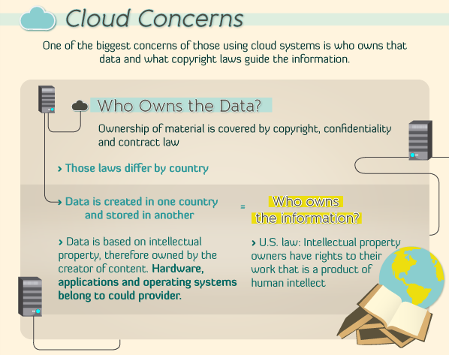

Slide 46
Instagram
Online photo-sharing site
In Dec. 2012, Instagram changed its terms of service
  Perpetual rights to all photos
  Right to sell photos to advertisers without payment or notice to the user
Instagram lost half its daily users in a month

Slide 47
AWS Outage
Dec. 24, 2012
Netflix was down, because they rely on AWS Amazon has had several other major outages

Slide 48
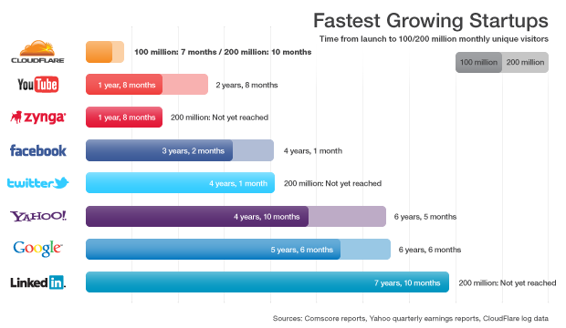

Slide 49
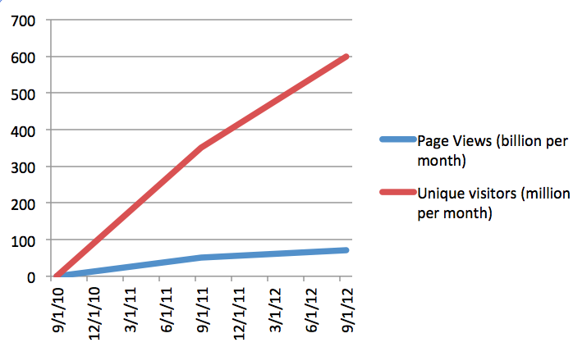
Cloudflare Growth

Slide 50
        Q&A
http://fpt.edu.vn

